Slide 1

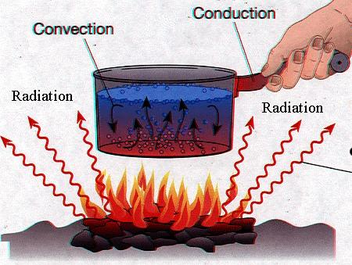
Conduction, Convection and Radiation Year 11 Physics
Mrs Martin
This Photo by Unknown Author is licensed under CC BY-SA

Slide 2
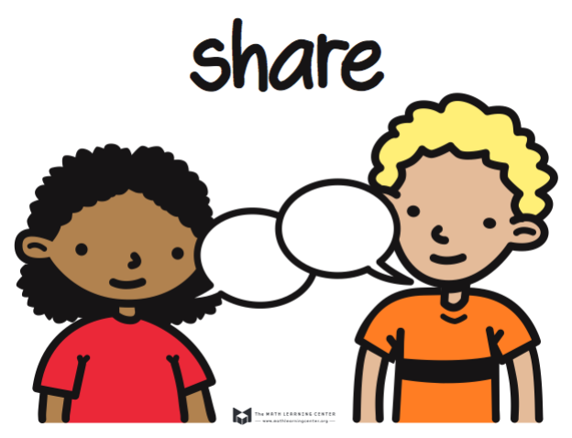


Do not delete this slide. It is hidden from your show. You can use it to copy and paste the relevant prompt boxes into your presentation. Click once on the white space to select it for copying. Once it is in your presentation you can double click on the white space to add text. The box will automatically resize to fit your text. The next slide is also hidden and included as an example only.
Make the Connection
Check for Understanding
Teacher Cue
Vocabulary
Extension
Hints

Slide 3
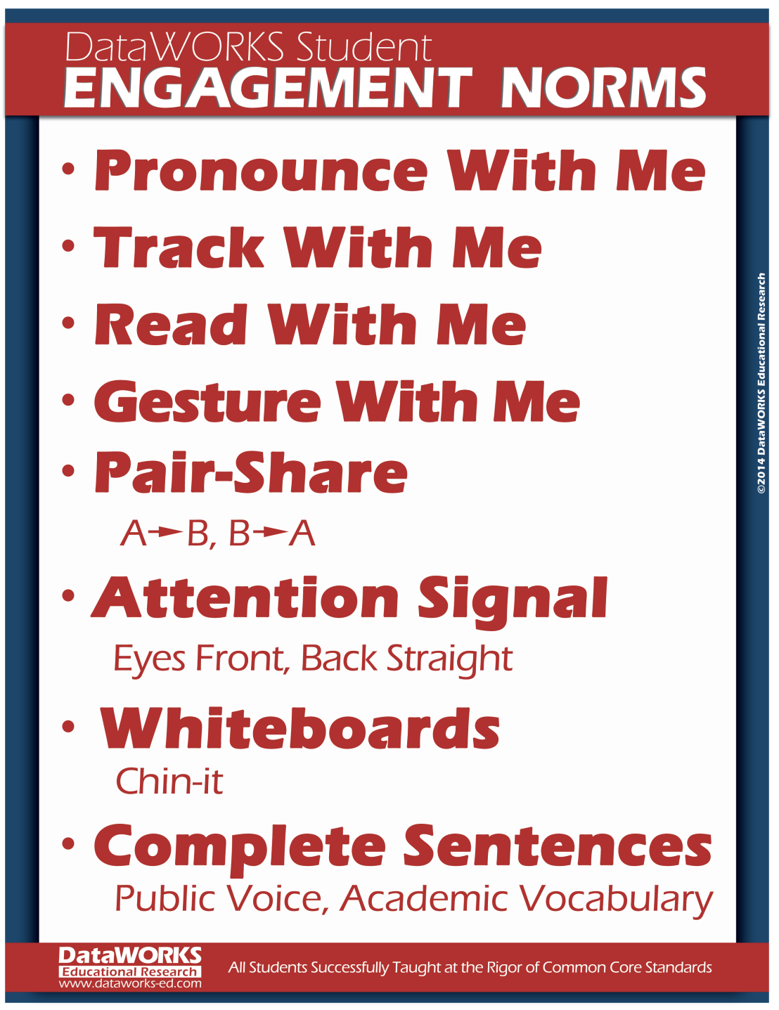
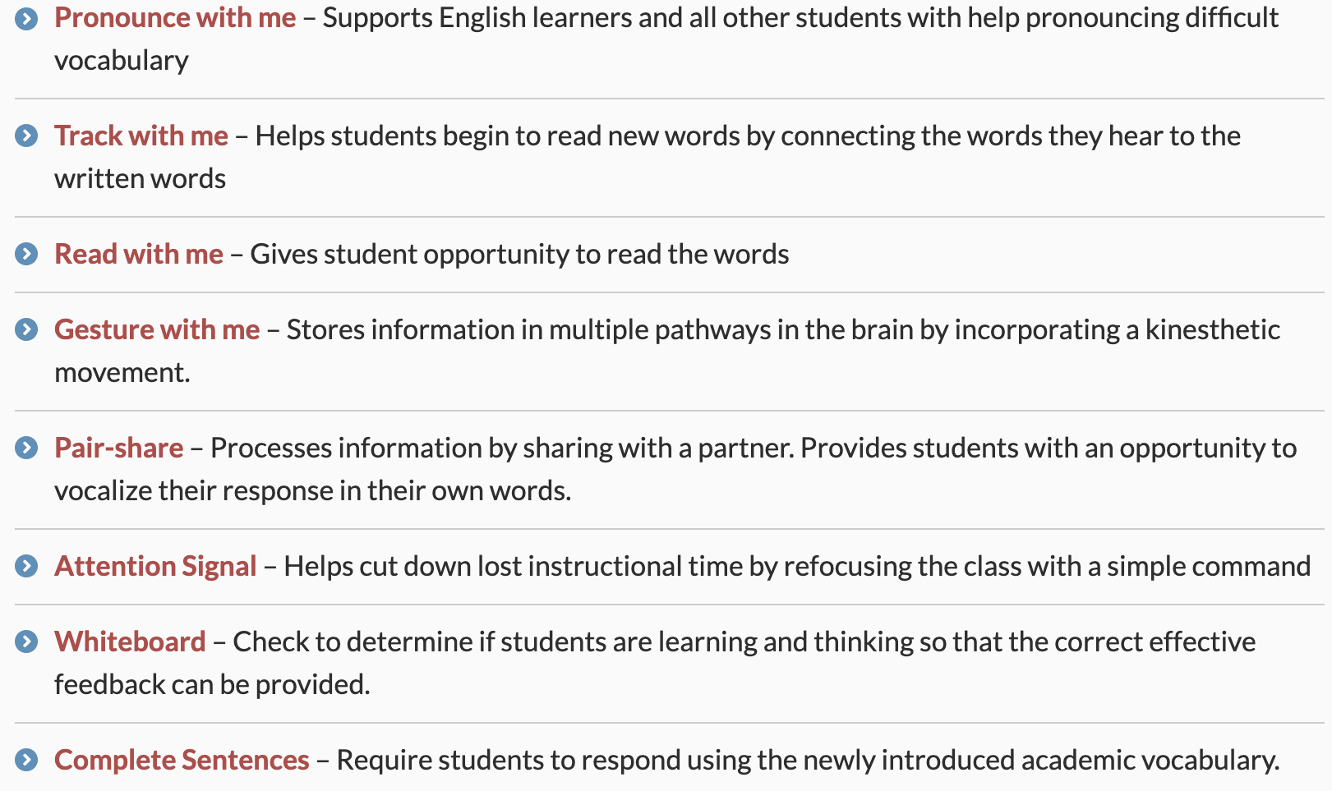

Slide 4
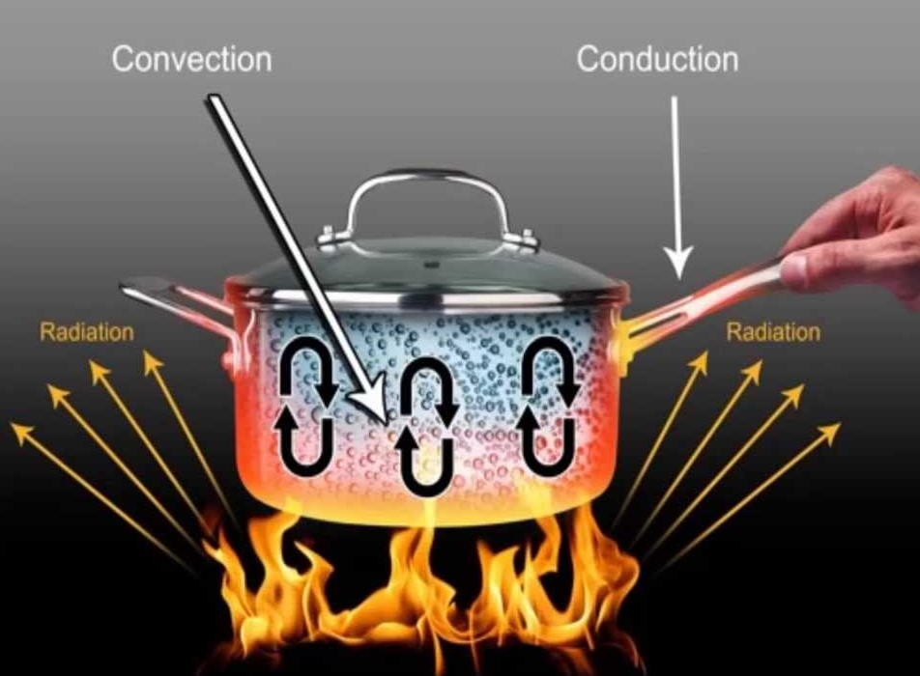
Heat transfer
Heat is transferred between objects through 3 different ways:
Conduction – direct contact
Convection – the flow of warm liquid/gas and cool liquid and gas
Radiation – transfer of heat from electromagnetic waves
This Photo by Unknown Author is licensed under CC BY-NC

Slide 5
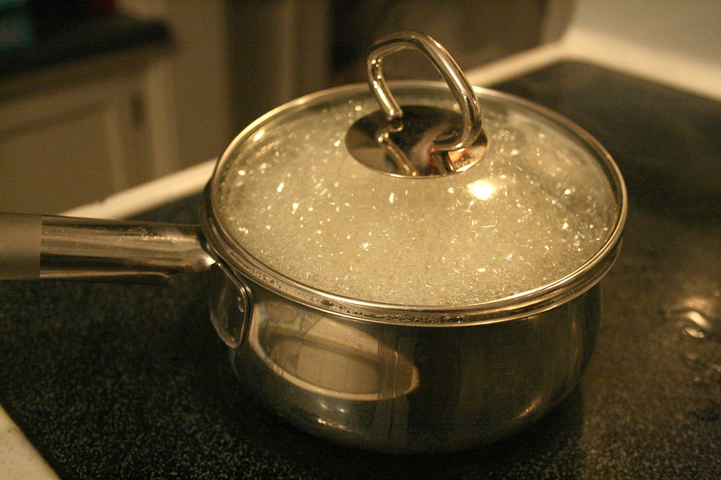
Boiling Water
Question:
You are cooking dinner and you need to boil water on an electric stove to cook pasta. Explain the physics behind how you boil the water.
This Photo by Unknown Author is licensed under CC BY-SA

Slide 6
Boiling Water
Salt is added to the water
Salt is added to water when boiling because the specific heat capacity for salt water is lower than the specific heat capacity of water. This means that is salt is added in the beginning less heat energy will be required to bring all the water up to boiling point.
2. Heating the pot
The pot is placed onto an electric stove. This allows heat to pass from the the stove top to the pot using conduction. The pot is made of metal which is a good conductor of heat. Allowing the heat to pass through to the water easily.

Slide 7
Boiling Water
3. Heating the water
The water and the pot are not in thermal equilibrium. So the pot transfers heat to water at the bottom of the pot. This causes convection currents as the hot water rises and the cool water sinks to the bottom. The top layer of water in the pot will always loose air to the surroundings.
4. Water boiling
Once the water reaches 100 degrees the water will start bubbling, indicating that it is starting to go through a phase change.

Slide 8
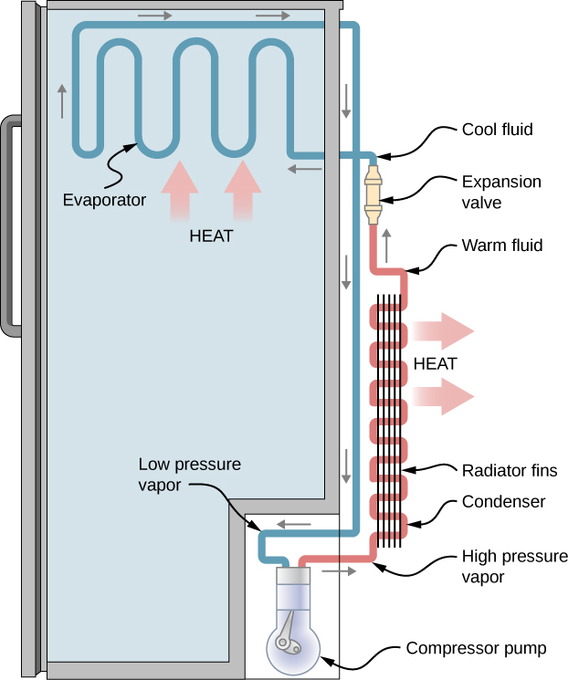
Example 2 Explaining how fridges work
Explain how a refrigerator works.
Refrigerators use convection currents to cool items inside. The excess heat is absorbed by a substance (refrigerant) till everything is in thermal equilibrium with each other.
The refrigerant goes through the throttling device.
This Photo by Unknown Author is licensed under CC BY-SA-NC

Slide 9
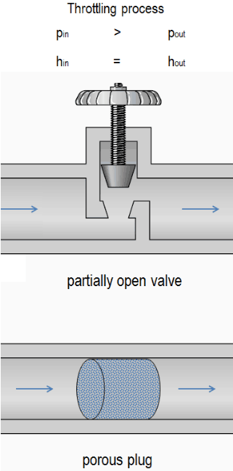
Throttling Device (Expansion Valves)
The throttling device reduces the pressure of the refrigerant before it goes into the fridge. The boiling point of the refrigerant is decreased.
This then cools the refrigerant till vaporization occurs. Meaning the refrigerant is in a partial liquid and vapor state.

Slide 10
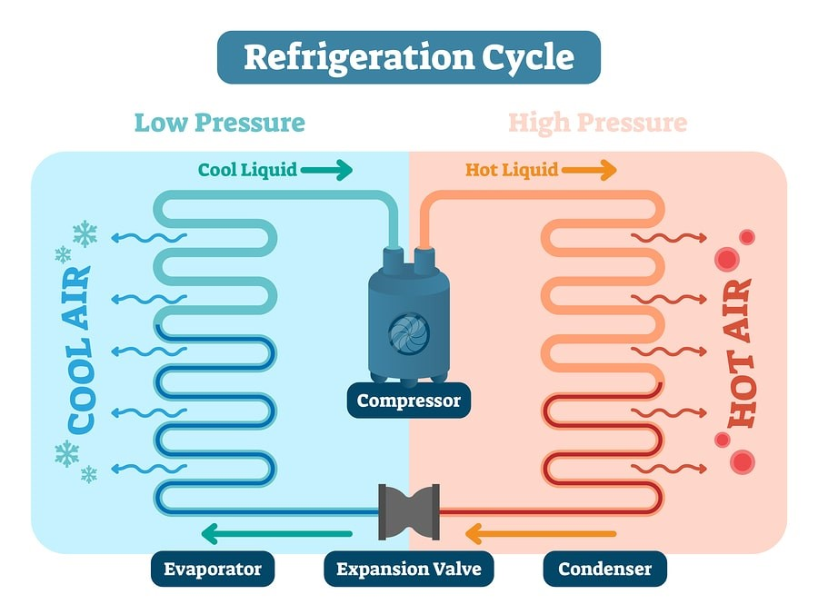
Evaporators
Evaporators are a series of tubing found in the back of the fridge.
The refrigerant passes through the evaporators. A fan is used to push the cool air around the fridge.
The refrigerant absorbs any heat, so that all the items in the fridge are in thermal equilibrium.
The refrigerant does not increase in temperature, instead the refrigerant goes from a liquid to a gas.

Slide 11
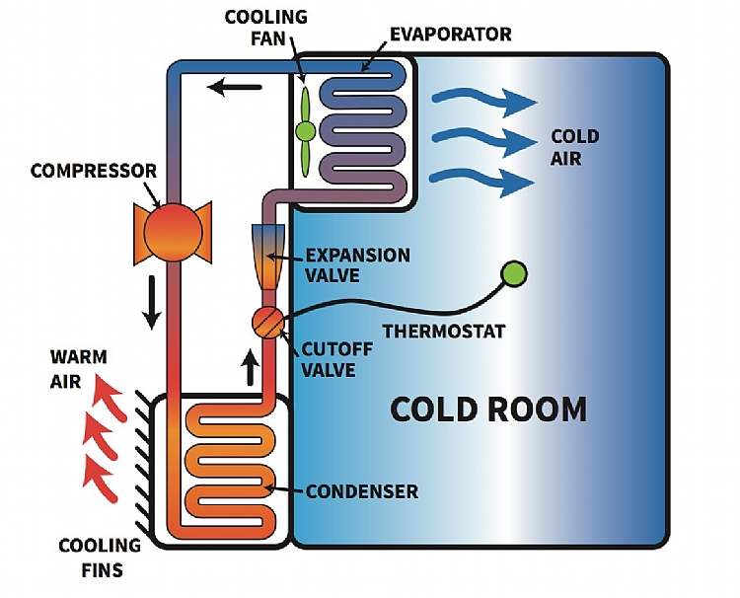
Compressor
After passing through the evaporator, the refrigerant goes through a compressor.
The compressor increases the pressure and temperature of the refrigerant. Meaning that all of the refrigerant is in a vapor state.

Slide 12
Condenser
In order to cool the refrigerant back to a liquid state it must be cooled. For this to happen it passes through the condenser.
The condenser is located on the outside of most fridges. It is very similar to the evaporator. Except instead of absorbing heat, the refrigerant gives heat to its surroundings.

Slide 13
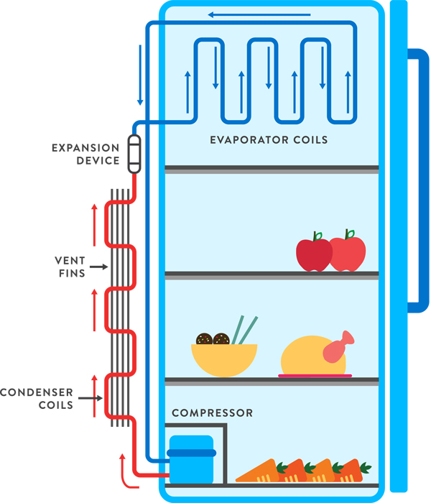
This Photo by Unknown Author is licensed under CC BY-SA-NC

